Slide 1
Pneumonia Detection Using AutoEncoders
Reviewer: Dr. Mira Kim
Instructor: Dr. Kanika Sood

Slide 2
Agenda
01
04
02
05
03
.
Developing the model
Deployment
Prediction
Demo
Developing frontend

Slide 3
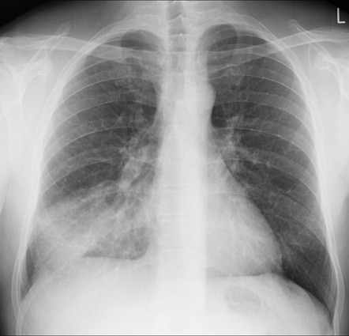
Problem
Determining which features in an X-ray or CT scan are most indicative of pneumonia can be challenging, especially given the subtle differences between pneumonia and other types of infections or artifacts.
Real-time analysis of imaging data in emergency settings is crucial for prompt treatment but challenging due to computational demands.
Even with a high-performing ML model, integrating these systems into clinical workflows without disrupting them poses a challenge. There are also issues related to the trust and interpretability of ML decisions by healthcare professionals.

Slide 4
Our Approach
My project aims to enhance the detection of pneumonia from medical imaging using a sophisticated machine learning pipeline that leverages autoencoders and convolutional neural networks (CNNs). We have developed a robust system that incorporates multiple stages of data processing, feature extraction, and classification, all hosted on a cloud platform for accessibility and scalability.
We have utilized a unique architecture for our autoencoders, identified through an extensive permutation search that tested various configurations to find the optimal structure for our specific task.
We utilize Docker for containerization, ensuring that our application is scalable, portable, and consistent across all deployment environments. Docker containers encapsulate our application and its environment, simplifying dependencies and streamlining deployment.

Slide 5
01
Developing the model

Slide 6
Tools
Python 3.9
Tensorflow Library for generating models
Autoencoders Feature Extraction
CNN(Convolutional Neural network) Classification
Matplotlib Visualization

Slide 7
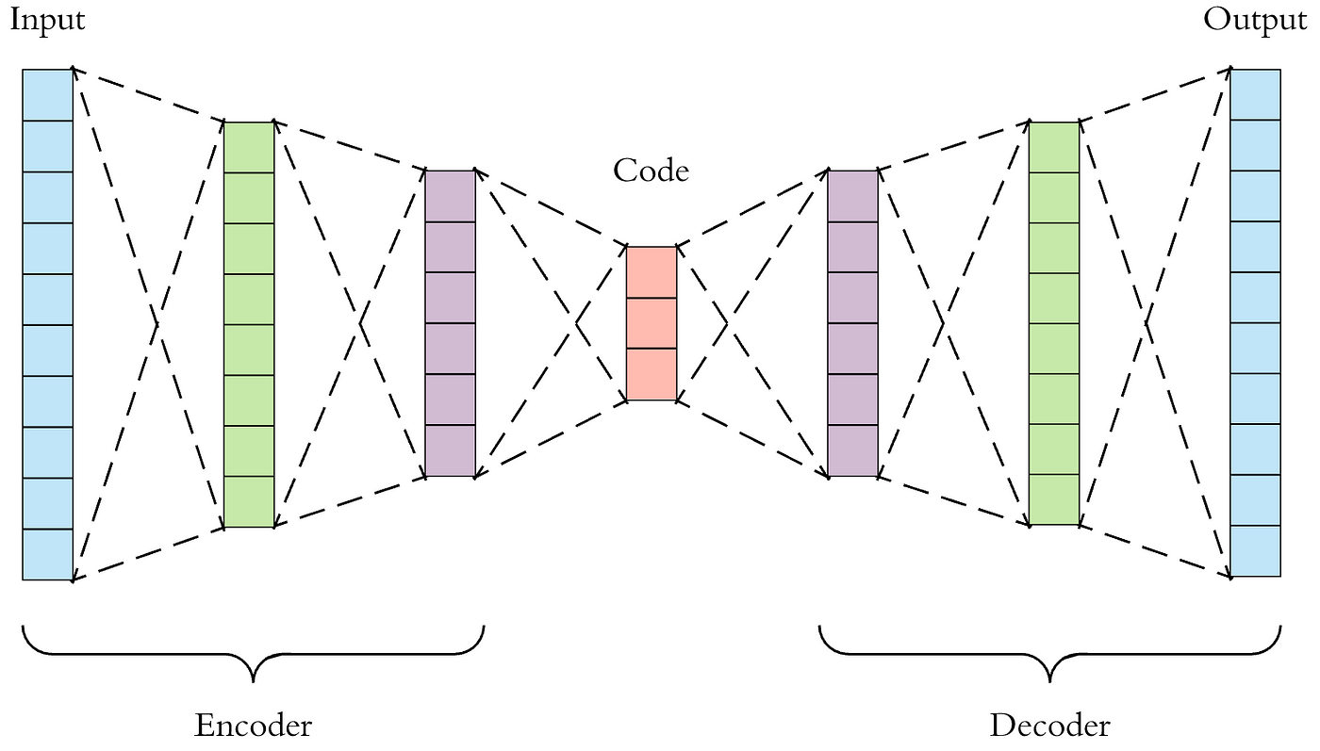
What is AutoEncoders ?
Autoencoders are a type of neural network designed for unsupervised learning, focusing on learning compressed representations of data. They consist of an encoder that reduces data to a lower-dimensional space and a decoder that reconstructs the data. This setup enables them to capture key features of the data, making them useful for dimensionality reduction, anomaly detection, and noise reduction.

Slide 8
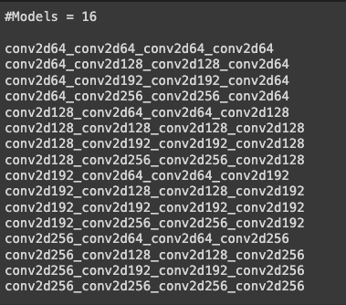
Process
Preprocessing the data
Resizing the image.
Normalizing the image after converting into numpy array for train, test and validation data.
Generating all the possible model

Slide 9
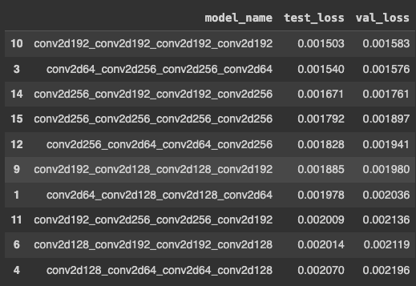
Process
Data was trained with an autoencoder to find the efficient last layer for the autoencoders used for feature extraction.
Model with 192 as last layer was the best model with least amount of loss.

Slide 10
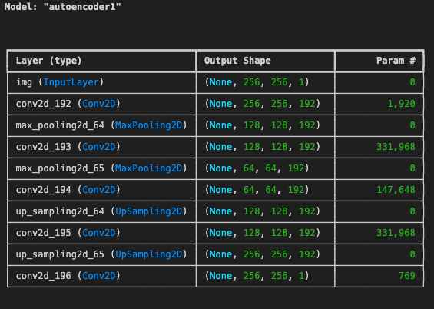
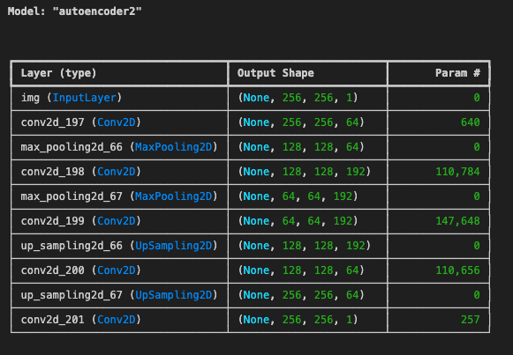
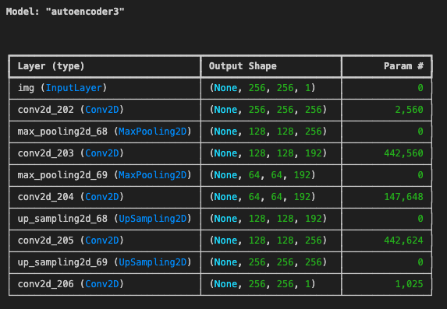
Process
Three AutoEncoders were developed and trained with the optimal Architecture obtained in last step
The Encoders of the AutoEncoder was used to reduce the dimension and extract features from (256,256,1) to (64,64,192). This clearly indicates that more feature are extracted with lesser image size.

Slide 11
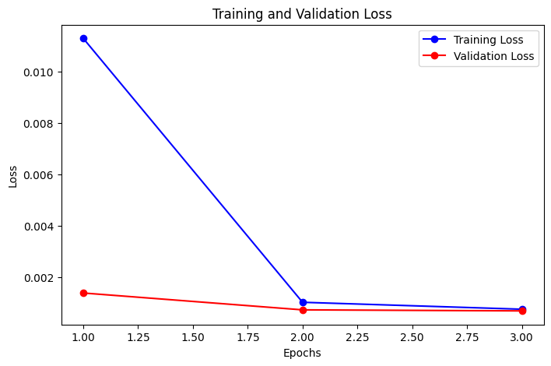
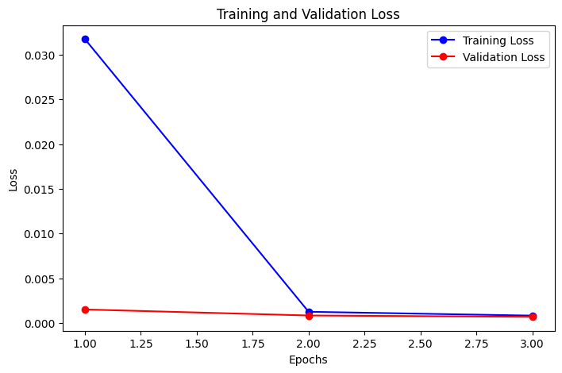
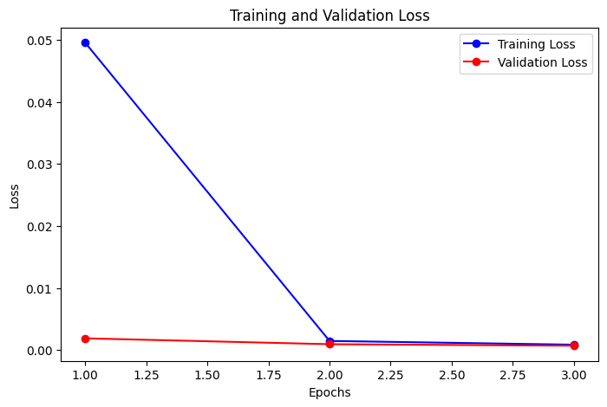
Loss Function of the AutoEncoders

Slide 12
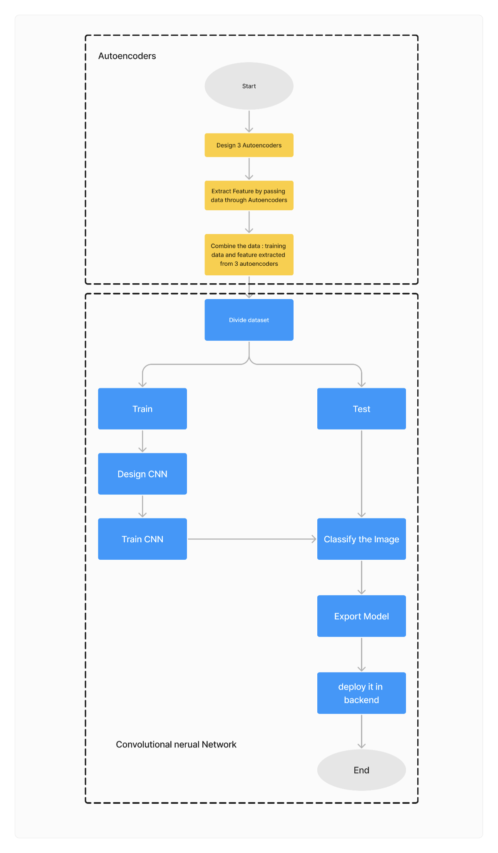
Functional Architecture of the Model

Slide 13
02
Prediction

Slide 14
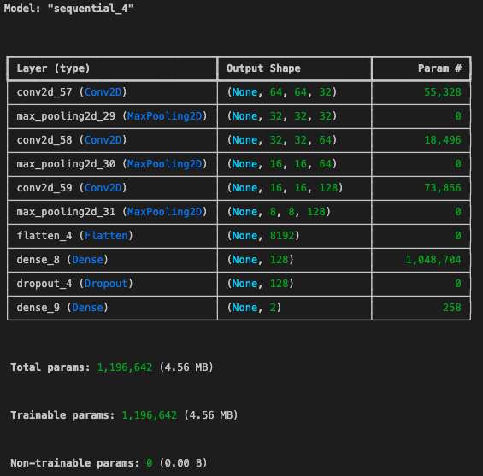
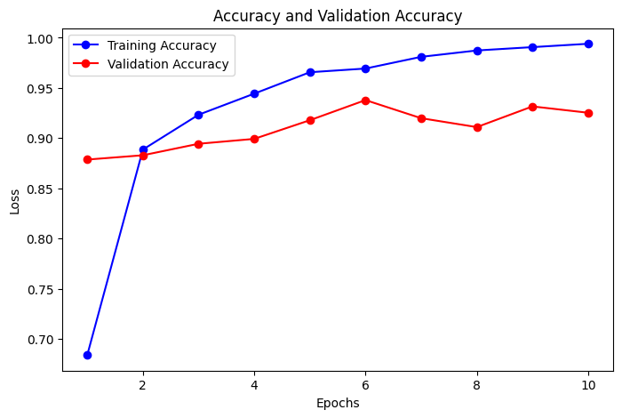
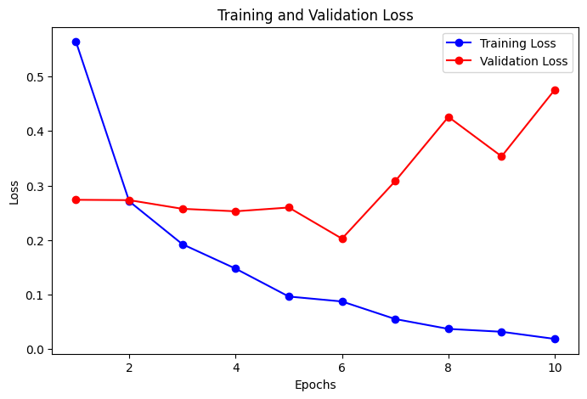
Classifier(CNN)
Extracted Features from the three autoencoders are concatenated into one numpy array.
CNN is Trained with numpy array.
Classifier when trained to perfection will output two classes from which we can find if the image is Pneumonic or normal based on the probability.

Slide 15
Deployment of Model
For easier deployment of the models 4 separate .h5 files where generated.
3 AutoEncoder .h5 files
1 Classifier .h5 files
This file format makes it easier for the model to be deployed in the cloud and lighter to be containerized inside the docker.

Slide 16
03
Developing frontend

Slide 17
Tools
TypeScript
React Library for developing frontend
Github Version control,website hosting, Test website
AWS- Amplify User and Authentication management
Flask Host the models in backend
Docker Containerize the backend
AWS LightSail API hosting

Slide 18
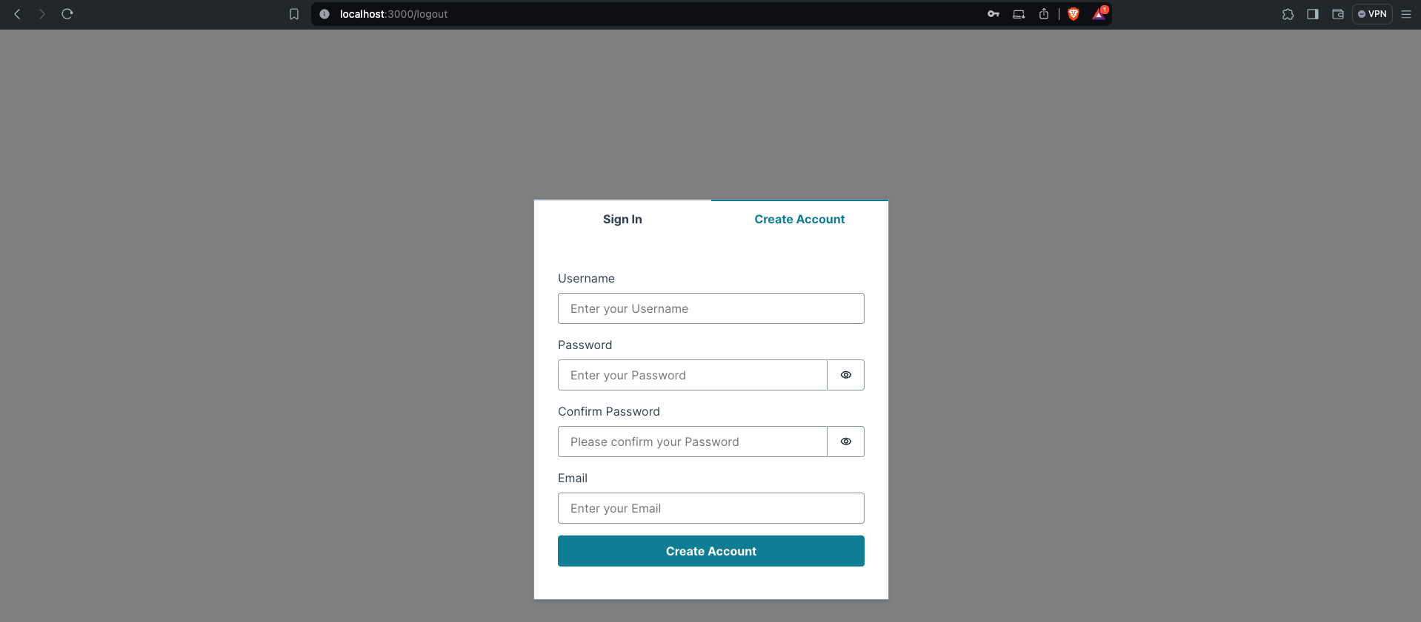
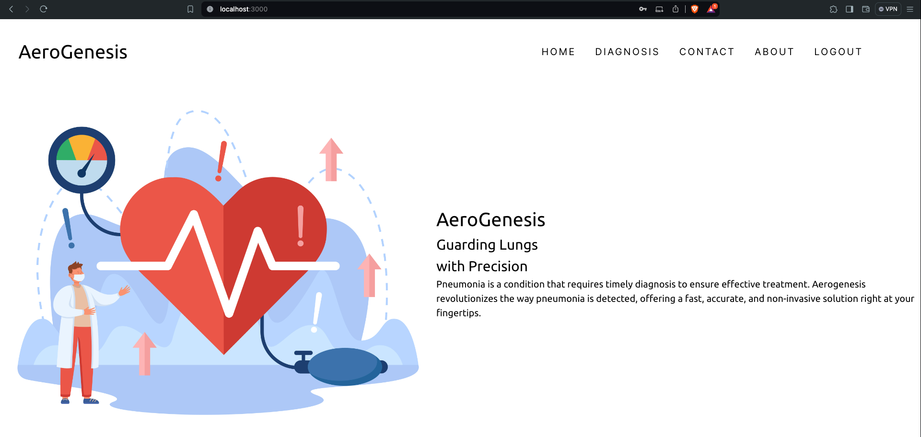
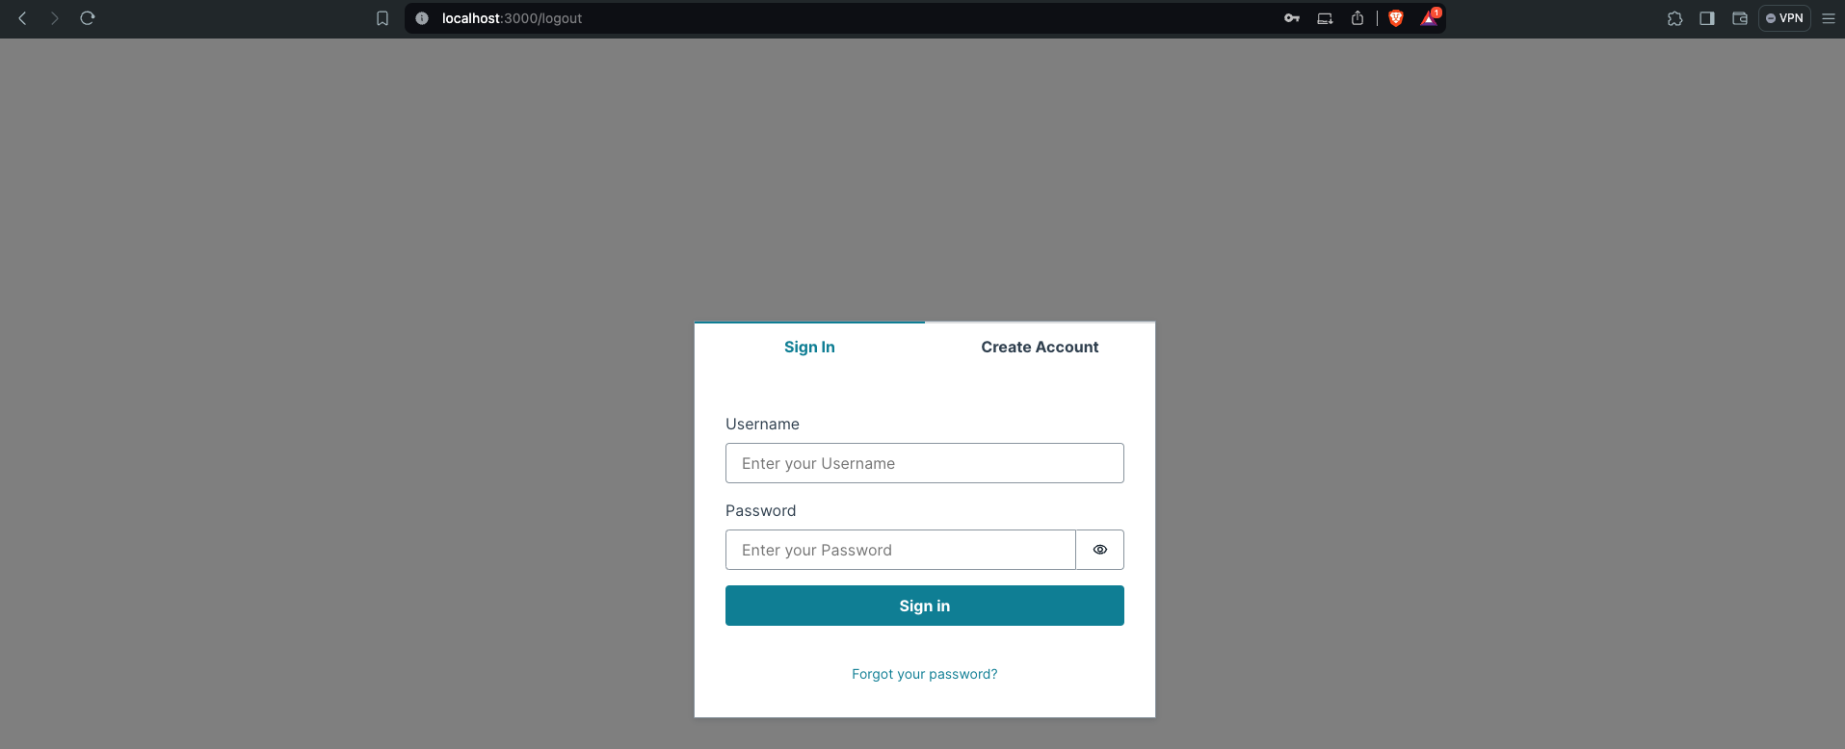

Web Application

Slide 19
04
Deployment

Slide 20

What is Docker ?
Docker is a platform and tool for building, distributing, and running applications inside lightweight containers. A container is a standardized unit of software that packages up code and all its dependencies so the application runs quickly and reliably from one computing environment to another.

Slide 21



Deployment
FrontEnd of the application will be hosted in github pages and CI/CD pipelines.
Generated model will be converted into REST API using Flask.
The Flask Application will be containerized into docker and will be pushed to AWS tailsage for cloud hosting.

Slide 22
Conclusion
Our pneumonia detection project successfully integrates deep learning and cloud technologies to create a robust and accessible diagnostic tool. Using three optimized autoencoders for feature extraction and a convolutional neural network (CNN) for classification, we achieved high accuracy in identifying pneumonia from X-ray images. The system's architecture was fine-tuned through a permutation search, ensuring optimal feature representation and sensitivity to anomalies specific to pneumonia.
Deployed on AWS LightSail via Docker and accessible through a React-based frontend, our solution emphasizes scalability, ease of use, and real-world applicability. This project not only advances pneumonia detection but also sets a precedent for deploying advanced machine learning models in healthcare, demonstrating the potential to enhance diagnostic processes and patient outcomes significantly.

Slide 23
References
A. Tilve, S. Nayak, S. Vernekar, D. Turi, P. R. Shetgaonkar and S. Aswale, "Pneumonia Detection Using Deep Learning Approaches," 2020 International Conference on Emerging Trends in Information Technology and Engineering (ic-ETITE), Vellore, India, 2020, pp. 1-8, doi: 10.1109/ic-ETITE47903.2020.152.
Baldi, P.. (2012). Autoencoders, Unsupervised Learning, and Deep Architectures. Proceedings of ICML Workshop on Unsupervised and Transfer Learning in Proceedings of Machine Learning Research 27:37-49 Available from https://proceedings.mlr.press/v27/baldi12a.html.
García-Ordás MT, Benítez-Andrades JA, García-Rodríguez I, Benavides C, Alaiz-Moretón H. Detecting Respiratory Pathologies Using Convolutional Neural Networks and Variational Autoencoders for Unbalancing Data. Sensors. 2020; 20(4):1214. https://doi.org/10.3390/s20041214.
Ibrahim, A.U., Ozsoz, M., Serte, S. et al. Pneumonia Classification Using Deep Learning from Chest X-ray Images During COVID-19. Cogn Comput (2021). https://doi.org/10.1007/s12559-020-09787-5

Slide 24
Thank You !
Any questions ?

